Slide 1
Airbnb User Insight Analysis
Shuli Ruan

Slide 2
Business Goals
Forecast the new users’ destination
Help Airbnb understand their user data insights, investigate potential target users and provide actionable recommendation on marketing campaign strategies

Slide 3
Univariate Analysis

Slide 4
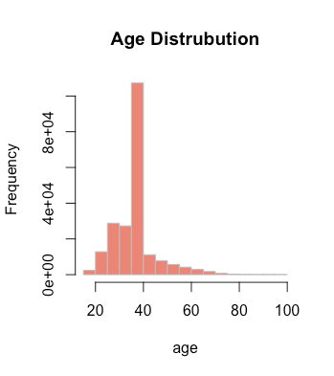
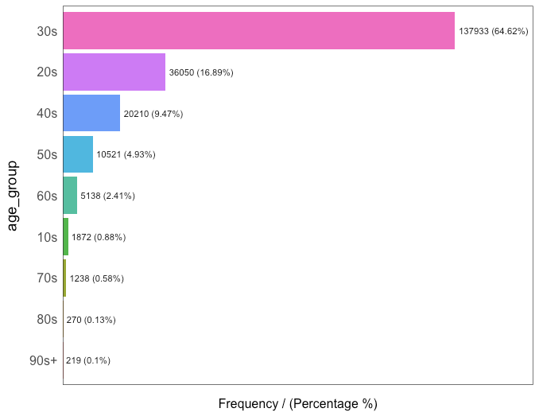
Age

Slide 5
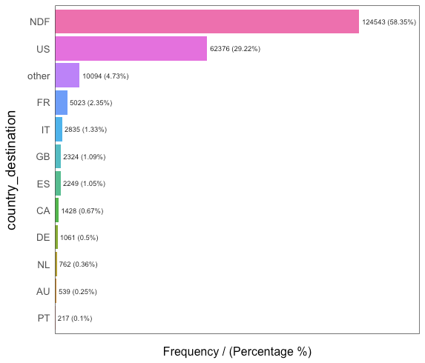
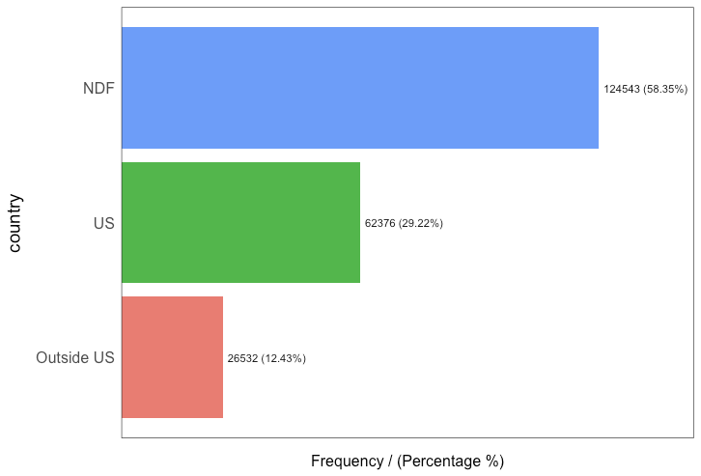
Country Destination

Slide 6
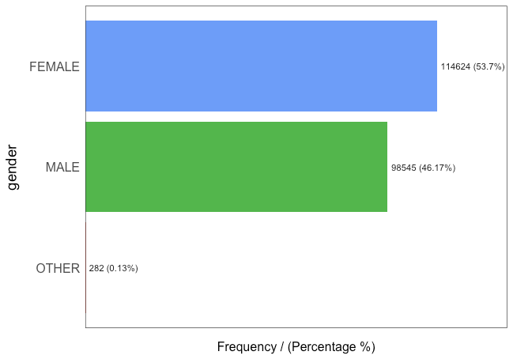
Gender

Slide 7
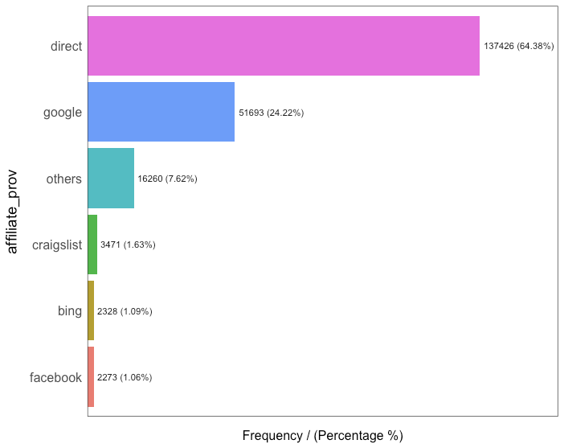
Affiliate Provider

Slide 8
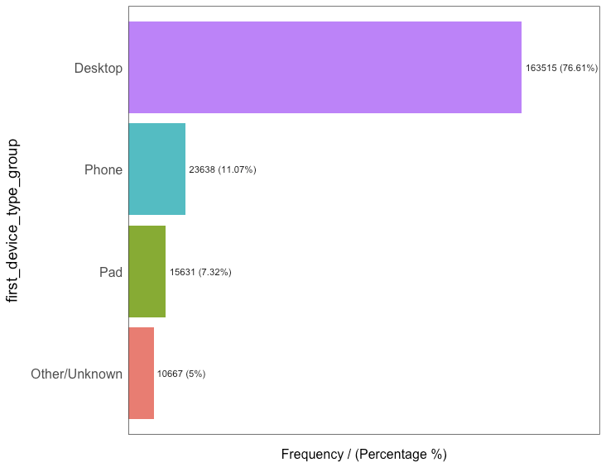
First Device Type

Slide 9
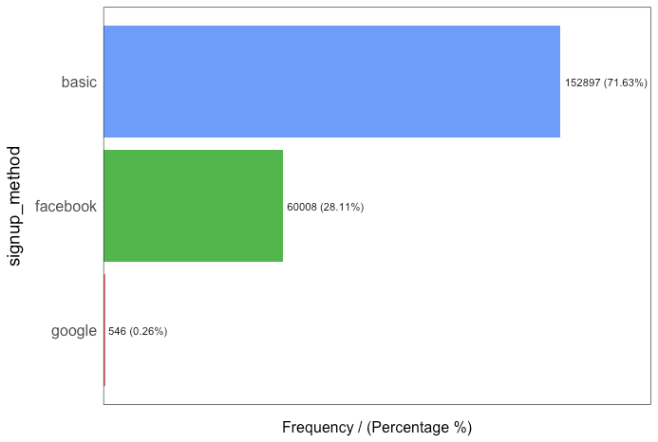
Signup Method

Slide 10
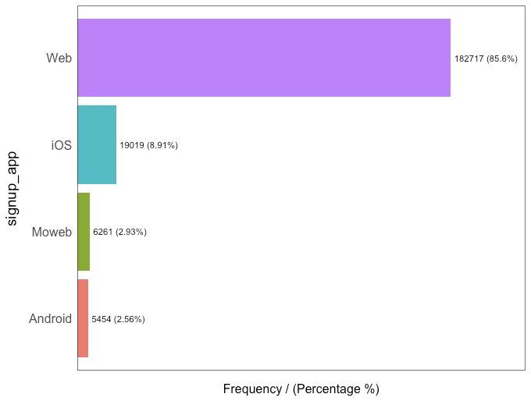
Signup App

Slide 11
Multivariate Analysis

Slide 12
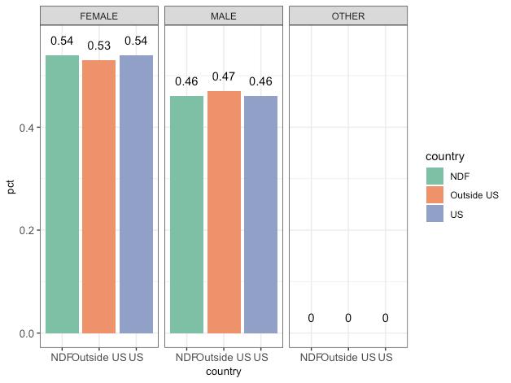
Gender

Slide 13
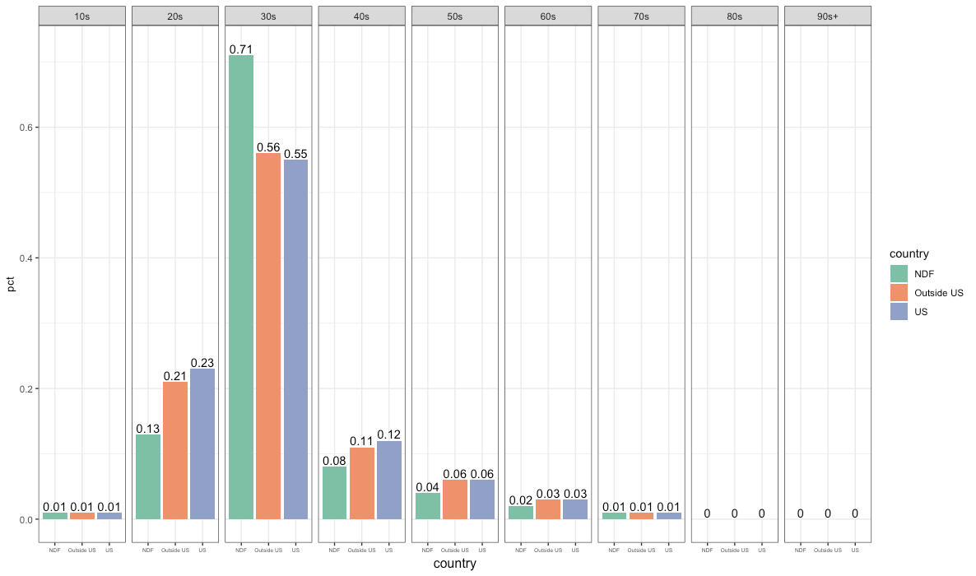
Age

Slide 14
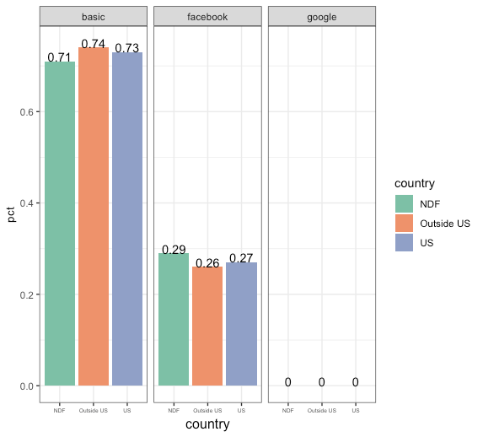
Signup Method

Slide 15
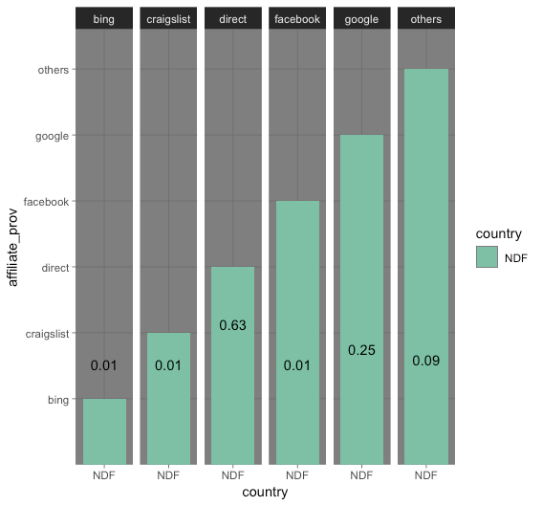
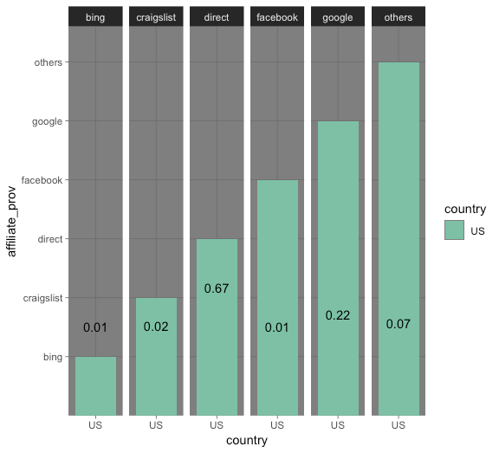
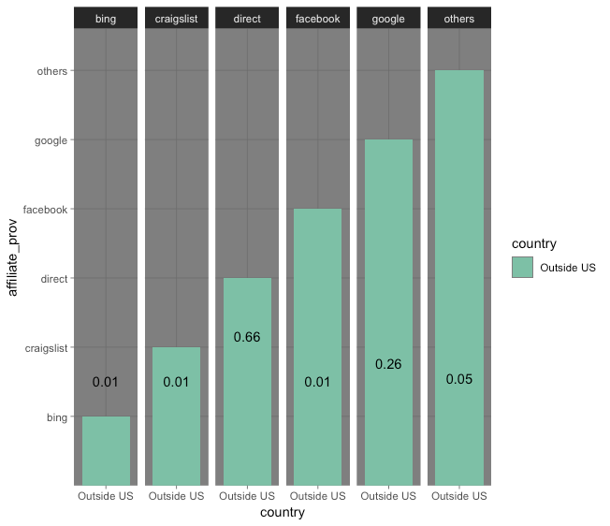
Affiliate Provider

Slide 16
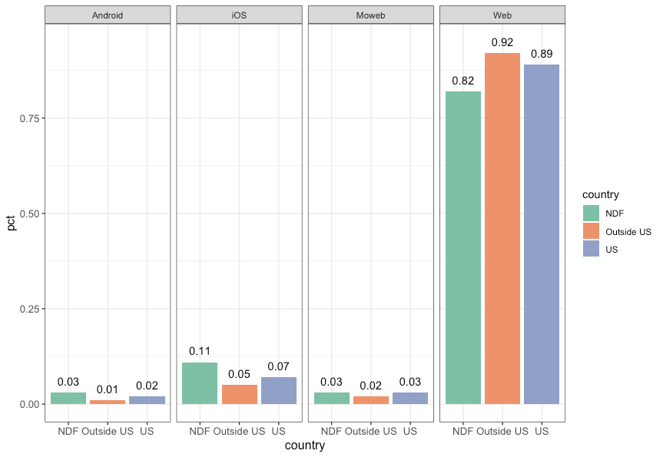
Signup App

Slide 17
Conclusion
Users:
Female
30s group
Device:
Pay more attention on other app
Affiliate:
Google (strong cooperation)
Facebook

